Slide 1
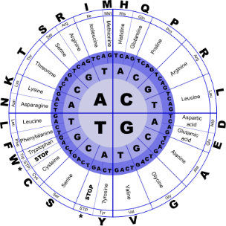
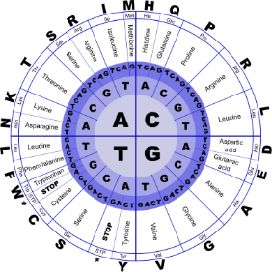


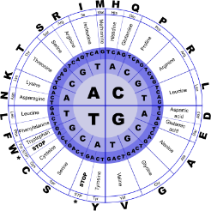
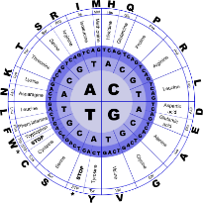
Fundamentals of Programming II
Strings

Slide 2
C-Strings
C-string: sequence of characters stored in adjacent memory locations and terminated by NULL character
The C-string
"Hi there!"
would be stored in memory as shown:
H
i
t
h
e
r
e
!
\0

Slide 3
What is NULL?
The null character is used to indicate the end of a string
It can be specified as
the character '\0'
the int value 0
the named constant NULL

Slide 4
Representation of C-strings
As a string literal
"Hi There!"
As a pointer to char
char *p;
As an array of characters
char str[20];
All three representations are pointers to char

Slide 5
String Literals
A string literal is stored as a null-terminated array of char
Compiler uses the address of the first character of the array as the value of the string
String literal is a pointer to char
value of "hi" is the
address of this array
h | i | \0

Slide 6
Array of char
An array of char can be defined and initialized to a C-string
char str1[20] = "hi";
An array of char can be defined and later have a string copied into it using strcpy or cin.getline
char str2[20], str3[20];
strcpy(str2, "hi");
cout << "Enter your name: ";
cin.getline(str3, 20);

Slide 7
Array of char
The name of an array of char is used as a pointer to char
Unlike a string literal, a C-string defined as an array can be referred to in other parts of the program by using the array name

Slide 8
Pointer to char
Defined as
char *pStr;
Does not itself allocate memory
Useful in repeatedly referring to C-strings defined as a string literal
pStr = "Hi there";
cout << pStr << " "
<< pStr;

Slide 9
Pointer to char
Pointer to char can also refer to C-strings defined as arrays of char
char str[20] = "hi";
char *pStr = str;
cout << pStr; // prints hi
Can dynamically allocate memory to be used for C-string using new

Slide 10
Library Functions with C-Strings
Require cstring header file
Functions take one or more C-strings as arguments. Argument can be:
Name of an array of char
pointer to char
string literal

Slide 11
Library Functions with C-Strings
int strlen(char *str)
Returns length of a C-string:
cout << strlen("hello");
Prints: 5
Note: This is the number of characters in the string, NOT the size of the array that contains it

Slide 12
strcat
strcat(char *dest, char *source)
Takes two C-strings as input. It adds the contents of the second string to the end of the first string:
char str1[15] = "Good ";
char str2[30] = "Morning!";
strcat(str1, str2);
cout << str1; // prints: Good Morning!
No automatic bounds checking: programmer must ensure that 1st string has enough room for result

Slide 13
strcpy
strcpy(char *dest, char *source)
Copies a string from a source address to a destination address
char name[15];
strcpy(name, "Deborah");
cout << name; // prints Deborah
Again, no automatic bounds checking

Slide 14
strcmp
int strcmp(char *str1, char*str2)
Compares strings stored at two addresses to determine their relative alphabetic order:
Returns a value:
less than 0 if str1 precedes str2
equal to 0 if str1 equals str2
greater than 0 if str1 succeeds str2

Slide 15
strcmp
Often used to test for equality
if(strcmp(str1, str2) == 0)
cout << "equal";
else
cout << "not equal";
Also used to determine ordering of C-strings in sorting applications
Note:
Comparisons are case-sensitive: "Hi" != "hi"
C-strings cannot be compared using == (compares addresses of C-strings, not contents)

Slide 16
strstr
char *strstr(char *str1,char *str2)
Searches for the occurrence of str2 within str1.
Returns a pointer to the occurrence of str2
within str1 if found, and returns NULL otherwise
char s[15] = "Abracadabra";
char *found = strstr(s,"dab");
cout << found; // prints dabra

Slide 17
Conversions Between Numbers and Strings
"1416" is a string; 1416 without quotes is an int
There are classes that can be used to convert between string and numeric forms of numbers
Need to include sstream header file

Slide 18
atoi and atol
atoi converts alphanumeric to int
atol converts alphanumeric to long
int atoi(char *numericStr)
long atol(char *numericStr)
Examples:
int number; long lnumber;
number = atoi("57");
lnumber = atol("50000");

Slide 19
atof
atof converts a numeric string to a floating point number, actually a double
double atof(char *numericStr)
Example:
double dnumber;
dnumber = atof("3.14159");

Slide 20
atoi, atol, atof
if C-string being converted contains non-digits, results are undefined
function may return result of conversion up to first non-digit
function may return 0
All functions require cstdlib

Slide 21
itoa
itoa converts an int to an alphanumeric string
Allows user to specify the base of conversion
itoa(int num, char *numStr, int base)
Example: To convert the number 1200 to a hexadecimal string
char numStr[10];
itoa(1200, numStr, 16);
The function performs no bounds-checking on the array numStr

Slide 22
Character Testing
require cctype header file
FUNCTION | MEANING
isalpha | true if arg. is a letter, false otherwise
isalnum | true if arg. is a letter or digit, false otherwise
isdigit | true if arg. is a digit 0-9, false otherwise
islower | true if arg. is lowercase letter, false otherwise

